Slide 1
Wintec Waiata
Presented by
Ray Smith, Tim Howard, Rewa Hill, Arielle Parai, Lee-Reign Ihaka, Jin Kiat Teo

Slide 2
Content
Prototype
Video of Wintec Waiata
Navigation Diagram

Slide 3
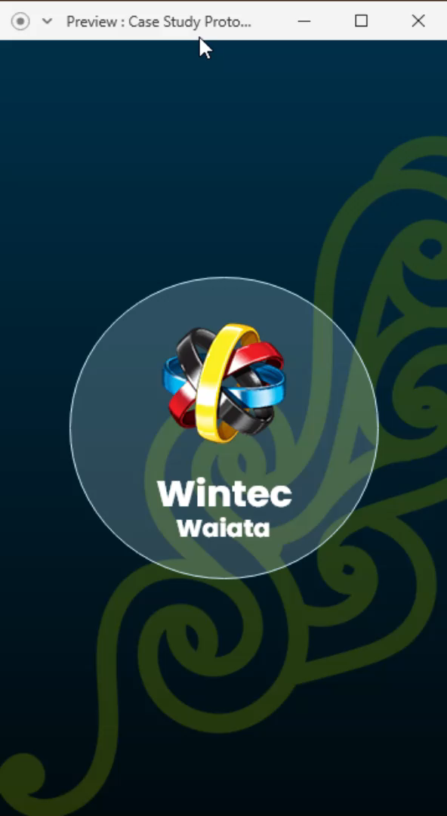
Prototype

Slide 4
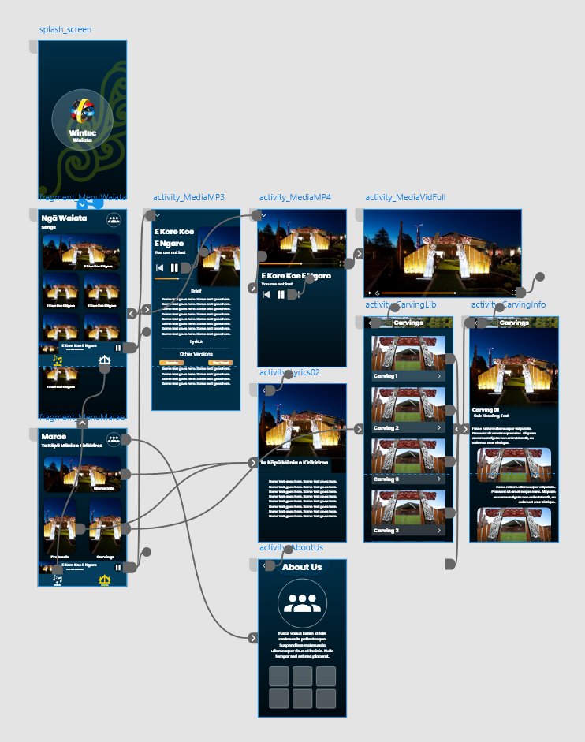
Prototype Navigation

Slide 5
Video of Wintec Waiata

Slide 6
Navigation Diagram

Slide 7
Thanks for tuning in!

